Slide 1

Welcome to Year 6

Slide 2
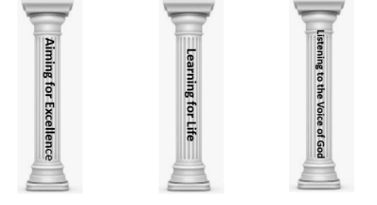

School’s Vision Statement
John 10:10 ‘Life in all its Fullness.’
John 10:10: Life in all its Fullness
Effective teaching and a creative, child centered curriculum, together with an emphasis on Christian values and beliefs, enables all learners to recognise and achieve high standards. Pupils are encouraged to embrace challenges and become lifelong learners in a safe, secure and nurturing environment. We are committed to enriching pupils’ moral and spiritual development inspiring all to become caring, responsible 21st century global citizens.
Notes:
If you have visited our website you may have read our mission statement; following on from a mock SIAMs, we have reviewed parts of this and underpinned our vision with a biblical reference. Presently there is a lot of research that states that children currently in education will be holding jobs that don’t even exist yet with technology that hasn’t even been invented. Therefore; it is our belief at South Bersted that we develop and nurture the whole child in becoming a reflective problem solver.
2

Slide 3

Year 6 Team
Class Teacher
Mr Thorn
Mrs Raynsford (PPA)
Teaching Assistants
Mrs Keates

Slide 4
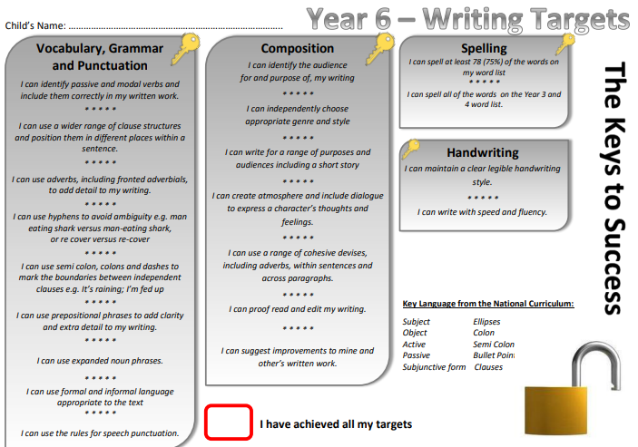

Year 6 - Keys to Success
Notes:
You will need to upload the Keys to Success from the website.

Slide 5
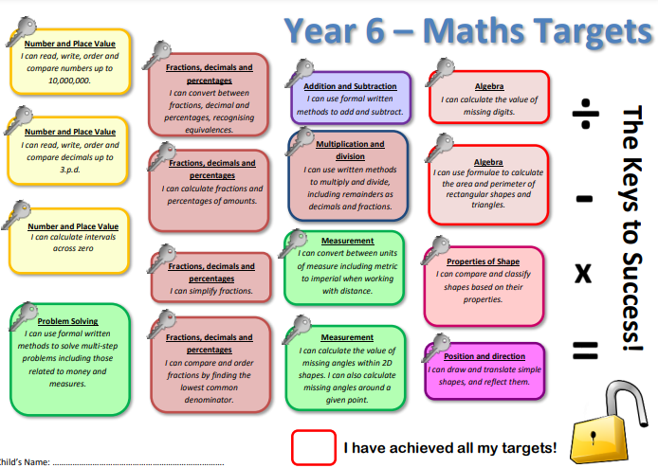
Year 6 - Keys to Success
Notes:
You will need to upload the Keys to Success from the website.

Slide 6
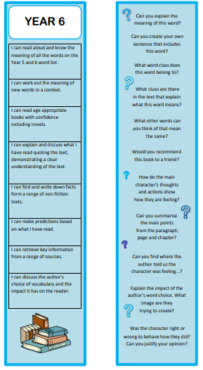

Reading Bookmarks
Notes:
Please add your year group’s book marks to this page.

Slide 7

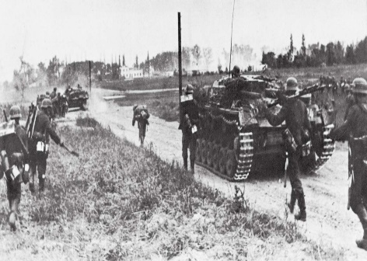
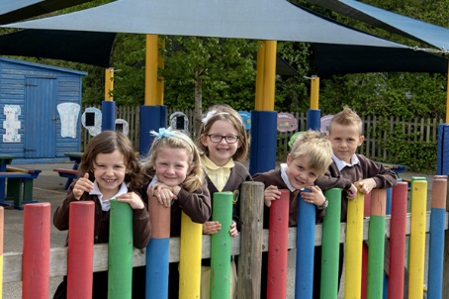
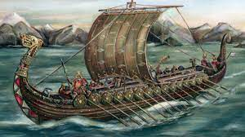

Year Sixes’ Curriculum
2026 - 2027
What is the beauty of the biomes of the Americas?
How was Britain impacted by WW2?
How did the Anglo-Saxons react to the Viking invasion?
What life lessons have I learnt from my time at Primary School?
Notes:
Please add your completed overview for the Autumn Term

Slide 8
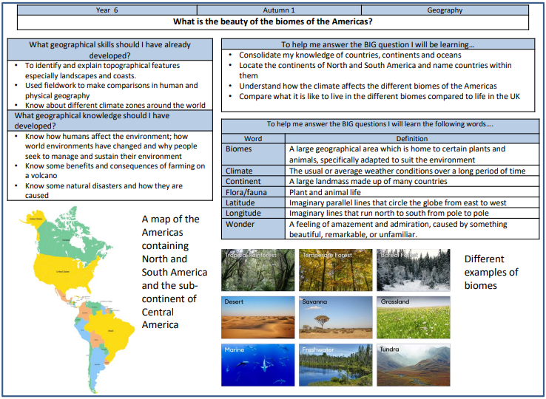

Knowledge Organiser Autumn 1

Slide 9
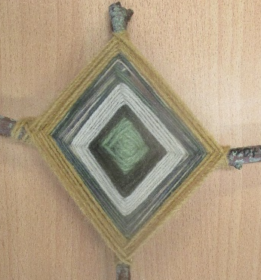
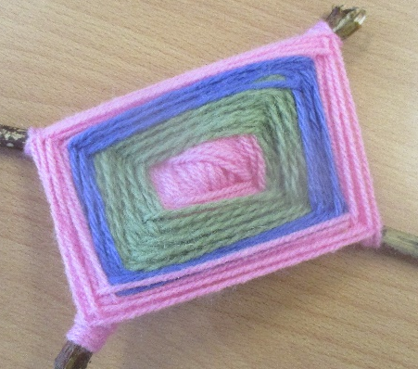
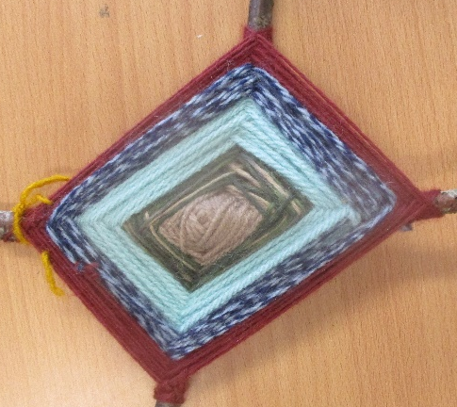

Outdoor Learning
Once a half term, pupils will take part in outdoor learning activities.
For the first half term, the focus for outdoor learning is art. The children will be making God’s eyes by weaving.
Notes:
Please add pictures of your stunning start

Slide 10


Giving your child an advantage
Reading:
Support your child’s fluency, stamina and understanding by listening to them read for at least 20 minutes a day. Please use your child’s bookmark to deepen their understanding.
Please complete your child’s reading record so we know that they have read and what they are reading.
Notes:
Add and delete as appropriate

Slide 11




I don’t want to read tonight!
Student ‘A’ reads 20 minutes each day.
3600 minutes in a school
year.
Student ‘B’ reads 5 minutes each day.
900 minutes in a school
year.
Student ‘C’ reads 1 minute each day.
180 minutes in a school
year.
1,800,000 words
282,000 words
8,000 words

Slide 12


Accelerated Reader
Children test at the beginning of each term
They are set a points target to aim for (gain by completing quizzes)
They are given a ZPD – reading range for books
Children complete quizzes on the book they have read (these contain between 5 – 20 questions)
We aim for children to get an average of 85% or above in their quizzes

Slide 13


Spellings:
We use ‘Spelling Shed’ to support our teaching and learning of spellings.
Each week your child will have 2 spelling lessons focused around a spelling rule or pattern.
They will then bring home activities to complete as part of home learning to support them to learn these rules.
Children will also be expected to log onto the spelling shed to compete in the online games.
Notes:
Add and delete as appropriate

Slide 14
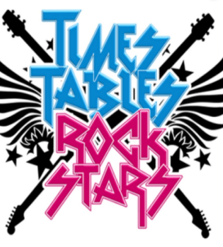
Maths:
Playing regularly will ensure that your child continues to develop their fluency in times tables,
This will support pupils when working with more complex mathematical concepts including fractions, decimals and percentages

Slide 15


Home Learning
Research shows that pupils completing their home learning improves progress by 3 months.
Home learning will be moving to: Google Classroom.
Each week your child will receive:
- a list of spellings to learn
- A maths task reviewing the learning from the week,
- Weekly Times Table Rockstar battles,
-SPAG book
- In promoting the school’s Christian Values, there may also be
additional whole school challenges set.
In Year 6, your child can attend the weekly Home Learning Club.

Slide 16

P.E kit
P.E: Thursday and Friday
Swimming: We will be providing catch up swimming later in the year. Details will follow.
P.E Kit: Navy shorts (long tracksuit trousers in the winter)
T-shirt, which is their team colour
Trainers for outdoor PE
Warm clothing in winter months such as a navy tracksuit.
If your child has an ear piercing it must be removed for the days that they have PE.

Slide 17


Healthy Minds
Please ensure that your child has a clear water bottle in school.
Bottles should be taken home and cleaned regularly.
Pupils may bring in their own fruit snack each day. It is no longer provided everyday.
On the days that your child does not do PE, they will walk, skip or run around the Daily Mile for 15 minutes.
Notes:
Delete as appropriate for KS 1 or 2

Slide 18
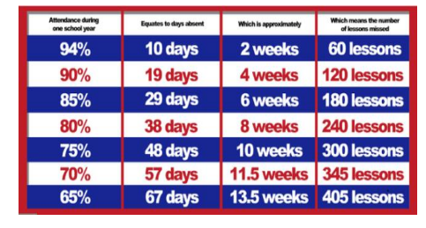

Attendance
The gates open at 8:35am and close at 8:45am. The register is taken at 8:50am.
If your child arrives after 9.15am, this will be recorded as an unauthorised absence.
Attendance of 96%+ is judged to be good.
Notes:
Please add what you give green dojos for

Slide 19

Attendance
Termly Prizes:
At the end of teach term, all children with 97%+ attendance goes into a raffle to win a prize.
Pupils who have 100% receive a certificate during Collective Worship.

Slide 20
Communication
Class Dojos for rewards and sanctions.
The School’s website.
School’s Facebook page.
MCAS
Class Pages.
(http://www.southbersted.w-sussex.sch.uk/class-pages/)
Weekly newsletters.
Parent teacher consultations.
Interim reports.
End of year reports.
Notes:
Please add what you give green dojos for

Slide 21
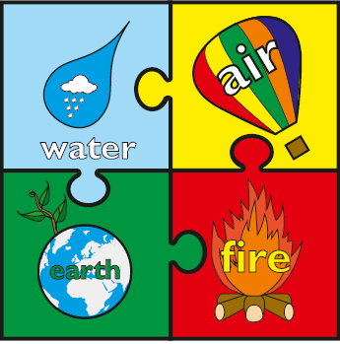

Rewards and Sanctions
Rewards:
Class Dojos – linked to our whole school House System.
Aiming for Excellence,
Acts of Kindness,
Perseverance
Weekly Gold Book.
Notes:
Currently, we are reviewing the whole school behaviour policy. At present these are our rewards and sanctions.
Please discuss the whole class rules and rewards that were created during the first week.

Slide 22
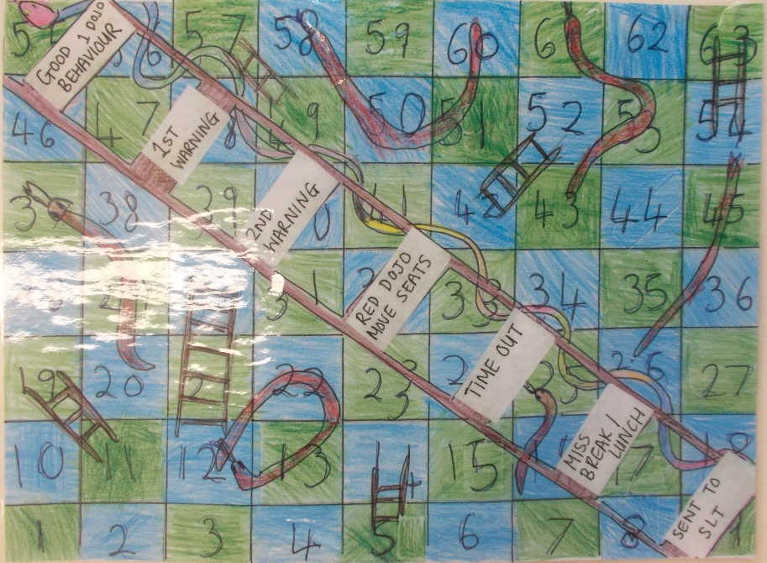
Rewards and Sanctions
Sanctions:

Slide 23



E-safety
SMART
Monthly newsletters – sent out by the school with useful guidance and links to relevant information

Slide 24
Key dates – SATS and Residential
SATS – Monday 10th May – Thursday 13th May
Fairthorne (residential) – Monday 12th – Wednesday 14th July
Fairthorne information meeting – Friday 2nd October
Bikeability – w/c 23rd November
First set of Mock SATS – w/c 28th September

