Slide 1


Welcome to Year 5
2026 - 2027

Slide 2
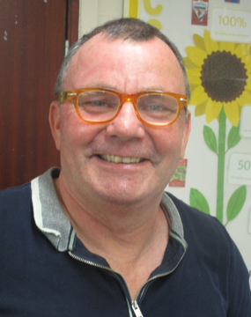
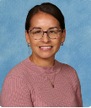
Year 5 Team
Class Teacher
Mr Shaw
Teaching Assistant
Mrs Holder

Slide 3
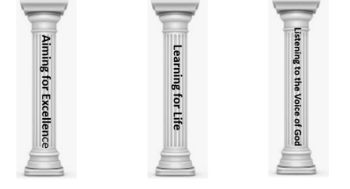

School’s Vision Statement
John 10:10 ‘Life in all its Fullness.’
John 10:10: Life in all its Fullness
Effective teaching and a creative, child centered curriculum, together with an emphasis on Christian values and beliefs, enables all learners to recognise and achieve high standards. Pupils are encouraged to embrace challenges and become lifelong learners in a safe, secure and nurturing environment. We are committed to enriching pupils’ moral and spiritual development inspiring all to become caring, responsible 21st century global citizens.
Notes:
The school’s Vision Statement is underpinned with a biblical reference. is our belief at South Bersted that we develop and nurture the whole child in becoming a reflective problem solver.
3

Slide 4
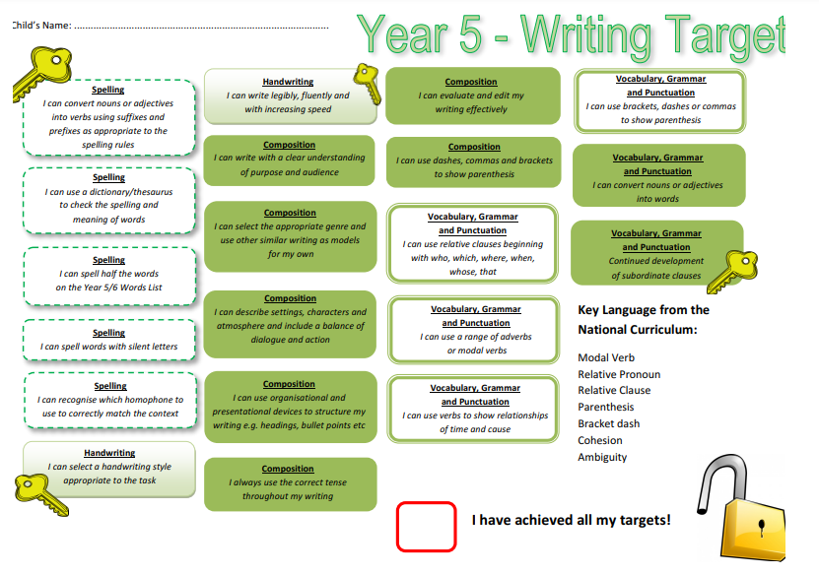

What are our milestones?
Notes:
You will need to upload the Keys to Success from the website.

Slide 5
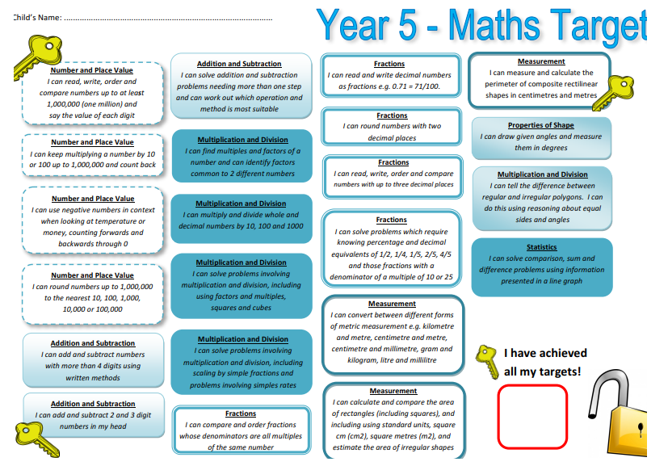
Notes:
You will need to upload the Keys to Success from the website.

Slide 6
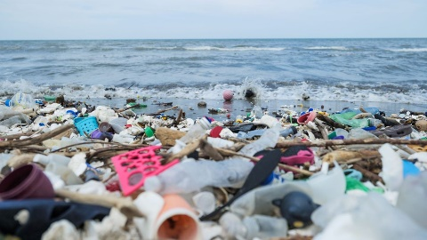
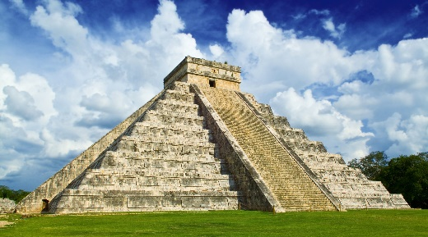

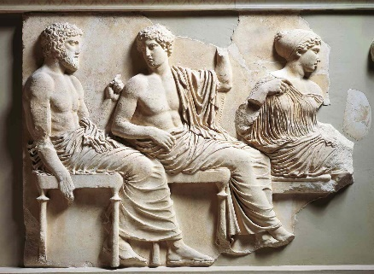
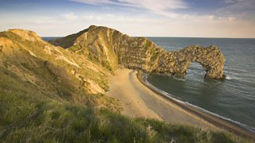

Year 5’s Curriculum
2026 - 2027
How can we sustain the world we live in?
How successful were the Maya as a civilisation?
Should we buy Fairtrade products?
What is it like to live in Mexico?
How did the ancient Greeks change the world?
Are all coastal locations the same?
Notes:
Please add your completed overview for the Autumn Term

Slide 7
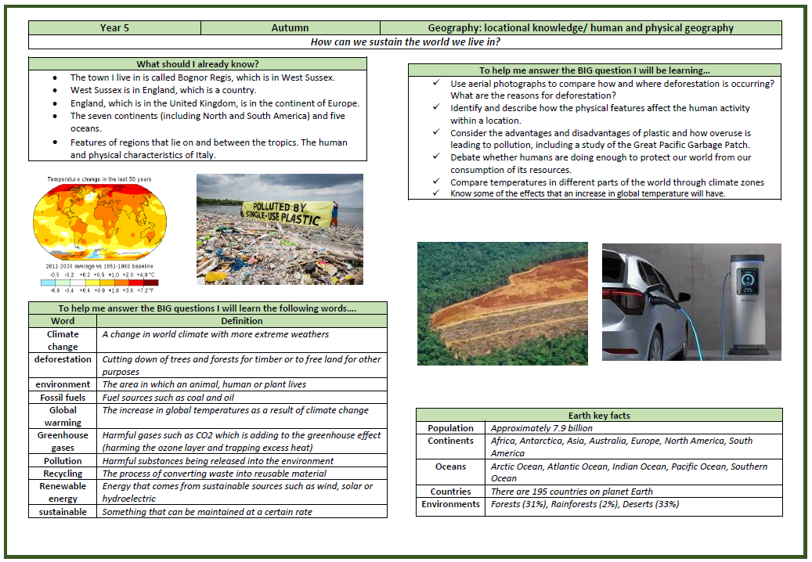

Knowledge Organiser Autumn 1

Slide 8
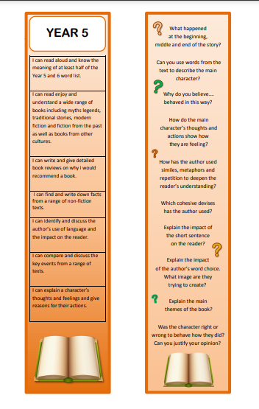

Reading Bookmarks
Notes:
Please add your year group’s book marks to this page.

Slide 9
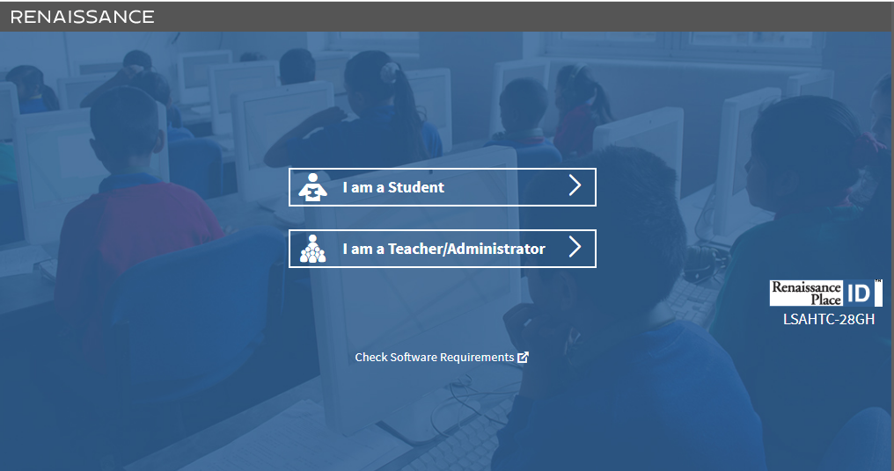

Accelerated Reader
Pupils will take their STAR test this week,
They are given a ZPD – reading range for books,
From this, your child will be set a reading target for the half term,
Children complete quizzes on the book they have read (these contain between 5 – 20 questions)
We aim for children to get an average of 85% or above in their quizzes.

Slide 10


Giving your child an advantage
Reading:
Support your child’s fluency, stamina and understanding by listening to them read for at least 20 minutes a day. Please use your child’s bookmark to deepen their understanding.
Please complete your child’s reading record so we know that they have read and what they are reading.
Notes:
Add and delete as appropriate

Slide 11




I don’t want to read tonight!
Student ‘A’ reads 20 minutes each day.
3600 minutes in a school
year.
Student ‘B’ reads 5 minutes each day.
900 minutes in a school
year.
Student ‘C’ reads 1 minutes each day.
180 minutes in a school
year.
1,800,000 words
282,000 words
8,000 words

Slide 12
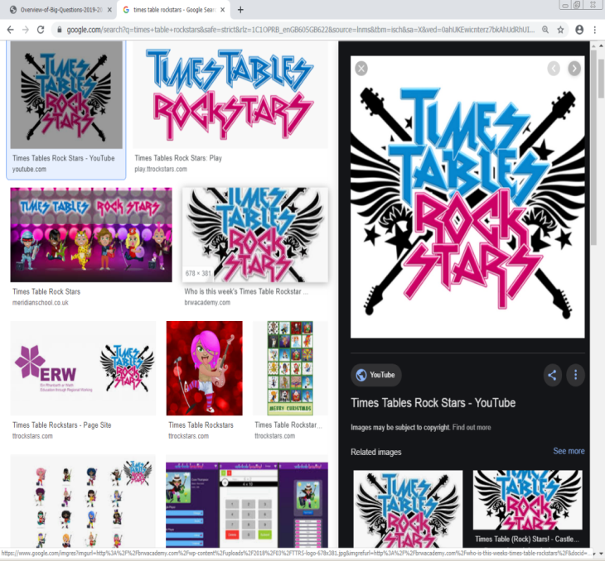
Maths:
Playing regularly will ensure that your child continues to develop their fluency in times tables,
This will support pupils when working with more complex mathematical concepts including fractions, decimals and percentages.

Slide 13

Spellings:
We use ‘Spelling Shed’ to support our teaching and learning of spellings.
Each week your child will have 2 spelling lessons focused around a spelling rule or pattern.
They will then bring home activities to complete as part of home learning to support them to learn these rules.
Children will also be expected to log onto the spelling shed to compete in the online games.

Slide 14


Home Learning
Research shows that pupils completing their home learning improves progress by 3 months.
Home learning will be set via Google Classroom.
Each week your child will receive:
- A maths task reviewing the learning from the week,
- Weekly Times Table Rockstar battles,
- Links to Accelerated Reader,
- Links to Spelling Shed.
In promoting the school’s Christian Values, there may also be
additional whole school challenges set.
In Year 5, your child can attend the weekly Home Learning Club.

Slide 15

P.E kit
P.E: Tuesday and Thursday
Swimming: We will go swimming in the Spring Term.
Details will follow.
P.E Kit: Navy shorts (long tracksuit trousers in the winter)
T-shirt, which is their team colour
Trainers for outdoor PE
Warm clothing in winter months such as a navy tracksuit.
If your child has an ear piercing it must be removed for the days that they have PE.

Slide 16


Healthy Minds
Please ensure that your child has a clear water bottle in school.
Bottles should be taken home and cleaned regularly.
Pupils may bring in their own fruit snack each day. It is no longer provided everyday.
On the days that your child does not do PE, they will walk, skip or run around the Daily Mile for 15 minutes.
Notes:
Delete as appropriate for KS 1 or 2

Slide 17
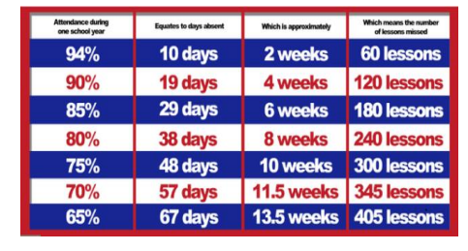

Attendance
The gates open at 8:35am and close at 8:45am. The register is taken at 8:50am.
If your child arrives after 9.15am, this will be recorded as an unauthorised absence.
Attendance of 96%+ is judged to be good.
Notes:
Please add what you give green dojos for

Slide 18

Attendance
Termly Prizes:
At the end of teach term, all children with 97%+ attendance goes into a raffle to win a prize.
Pupils who have 100% receive a certificate during Collective Worship.

Slide 19
Communication
Class Dojos for rewards and sanctions.
The School’s website.
School’s Facebook page.
MCAS
Class Pages.
(http://www.southbersted.w-sussex.sch.uk/class-pages/)
Weekly newsletters.
Parent teacher consultations.
Interim reports.
End of year reports.
Notes:
Please add what you give green dojos for

Slide 20
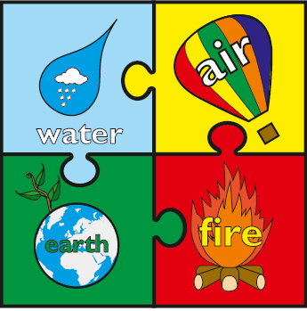

Rewards and Sanctions
Rewards:
Class Dojos – linked to our whole school House System.
Aiming for Excellence,
Acts of Kindness,
Perseverance
Weekly Gold Book.
Notes:
Currently, we are reviewing the whole school behaviour policy. At present these are our rewards and sanctions.
Please discuss the whole class rules and rewards that were created during the first week.

Slide 21
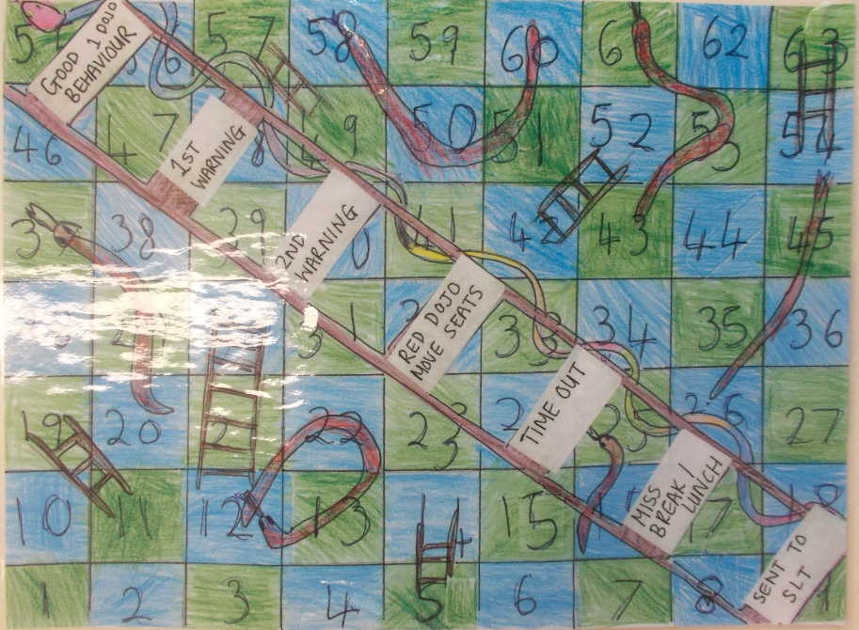
Rewards and Sanctions
Sanctions:

Slide 22



E-safety
SMART
Monthly newsletters – sent out by the school with useful guidance and links to relevant information

Slide 23
Key Dates
Planetarium: 7th October 2026 – letter to come out this week
Bike Ability – Friday 27th November, 2026
Form MRF 7th December 2026 – letter to follow

