Slide 1


Welcome to Year 2

Slide 2

Year 2 Team
Class Teacher
Mrs Beaumont
Teaching Assistant
Ms Osborne

Slide 3
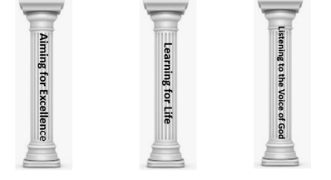

School’s Vision Statement
John 10:10 ‘Life in all its Fullness.’
John 10:10: Life in all its Fullness
Effective teaching and a creative, child centered curriculum, together with an emphasis on Christian values and beliefs, enables all learners to recognise and achieve high standards. Pupils are encouraged to embrace challenges and become lifelong learners in a safe, secure and nurturing environment. We are committed to enriching pupils’ moral and spiritual development inspiring all to become caring, responsible 21st century global citizens.
Notes:
If you have visited our website you may have read our mission statement; following on from a mock SIAMs, we have reviewed parts of this and underpinned our vision with a biblical reference. Presently there is a lot of research that states that children currently in education will be holding jobs that don’t even exist yet with technology that hasn’t even been invented. Therefore; it is our belief at South Bersted that we develop and nurture the whole child in becoming a reflective problem solver.
3

Slide 4
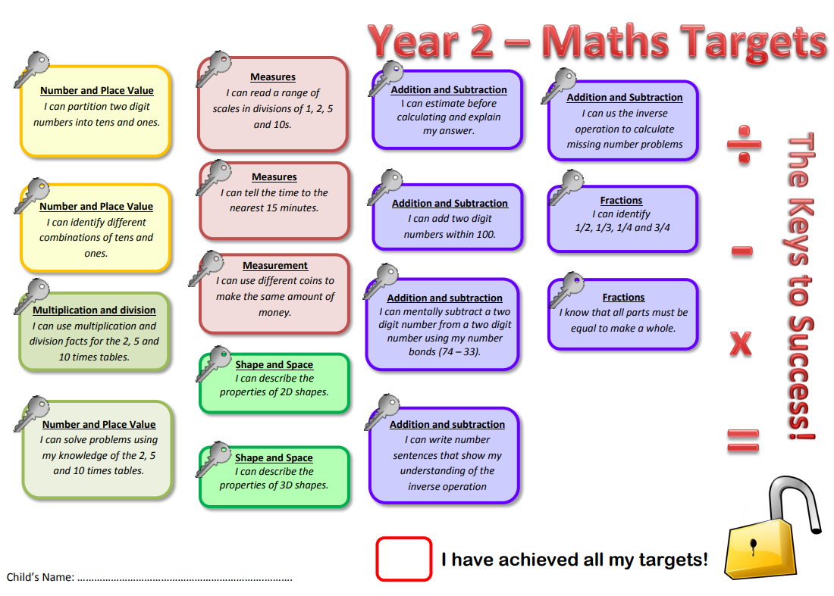

Year 2 - Keys to Success
Notes:
You will need to upload the Keys to Success from the website.

Slide 5
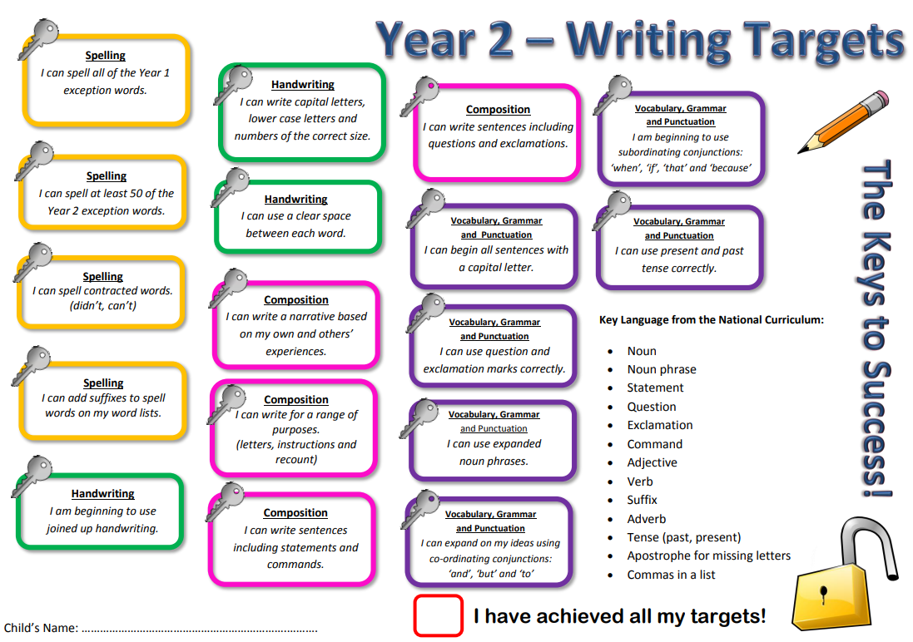
Year 2 - Keys to Success
Notes:
You will need to upload the Keys to Success from the website.

Slide 6
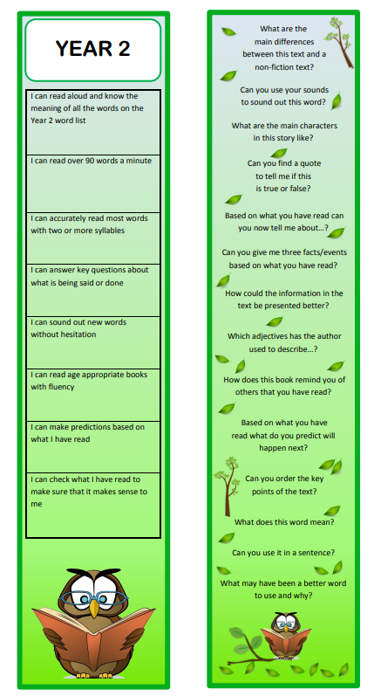

Reading Bookmarks
Notes:
Please add your year group’s book marks to this page.

Slide 7
End of Key Stage 1 Assessments
These will still take place next year
Children are assessed on Reading, Maths, Spelling, Punctuation and Grammar
Tests are used to support teacher assessment
These will be made as friendly as possible for the children to enable them to do their best and not feel under any stress.

Slide 8

Year Two’s Curriculum
2026 - 2027
Autumn 1 | Autumn 2 | Spring 1 | Spring 2 | Summer 1 | Summer 2
Would you put the fire out? | What does it take to make a change? | Where would you dare to explore? |  | Where shall I build my castle? | Why are bees important?
Notes:
Please add your completed overview for the Autumn Term

Slide 9
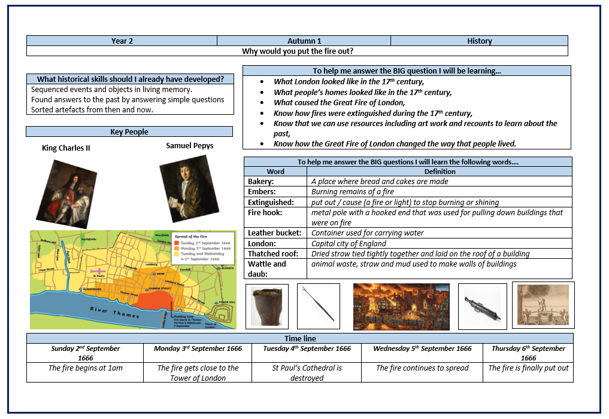

Knowledge Organiser Autumn 1

Slide 10
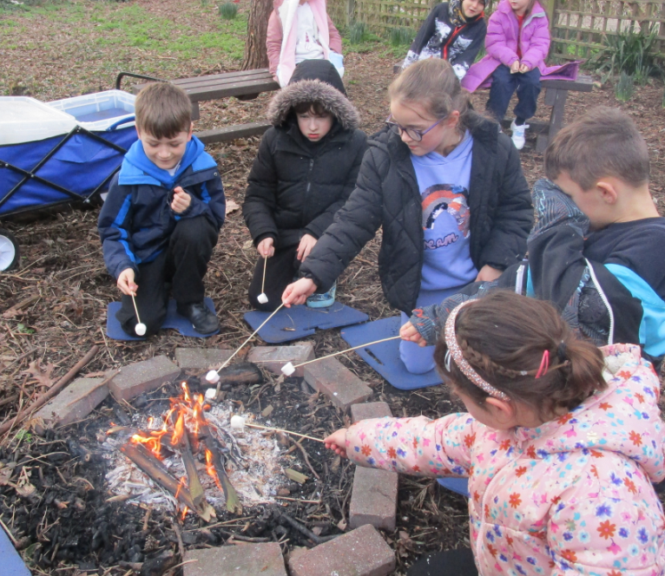

Outdoor Learning
Once a half term, pupils will take part in outdoor learning activities.
For the first half term, the focus for outdoor learning is art. There is no need for a change of clothes on this day.
Notes:
Please add pictures of your stunning start

Slide 11


Home Learning
Home learning is now set via Class Dojo
Each week your child will receive:
- spellings to learn
- A maths task linked to the weeks learning or the learning that is coming up the following week
- In promoting the school’s Christian Values, there may also be
additional whole school challenges set.

Slide 12


Giving your child an advantage
Reading:
Support your child’s fluency, stamina and understanding by listening to them read each day.
Please use your child’s bookmark to deepen their understanding.
Please complete your child’s reading record so we know that they have read and what they are reading.
Notes:
Add and delete as appropriate

Slide 13


Spellings:
This year we will be using the ‘Spelling Shed’ to support our teaching and learning of spellings.
Each week your child will have 2 spelling lessons focused around a spelling rule or pattern.
They will then bring home activities to complete as part of home learning to support them to learn these rules.
Children will also be expected to log onto the spelling shed to compete in the online games.
Notes:
Add and delete as appropriate

Slide 14

Maths:
Learn number bonds to 10, 20 and 100.
Revisit them frequently 10 + 0 = 10, 20 – 2 = 18 ,
100 – 20 = 80 etc.
Support your child in learning by using internet maths games: Numbots etc.
Encourage opportunities to explore measures and money, shopping.

Slide 15

Accelerated Reader
Each half term, your child will take an assessment which will set them a reading target and determine the level of book they should be reading.
Each time your child reads a book, they can take a quiz which will give them a score towards that target and calculate the number of words read.
Your child can access their Accelerated Reader Account from home.

Slide 16

P.E kit
Monday and Friday
P.E Kit: Navy shorts
T-shirt, which is their team colour
Plimsolls or trainers (for outdoor work)
Warm clothing in winter months such as a tracksuit.
If your child has an ear piercing it must be removed for the days that they have PE.

Slide 17


Healthy Minds
Please ensure that your child has a clear water bottle in school.
Bottles should be taken home and cleaned regularly.
Bottles should only contain water
Pupils may bring in their own fruit snack each day.
Notes:
Delete as appropriate for KS 1 or 2

Slide 18
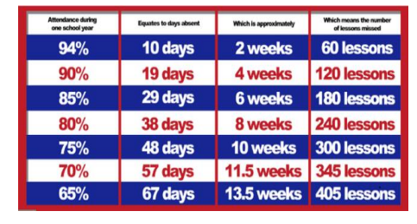

Attendance
The gates open at 8:35am and close at 8:45am. The register is taken at 8:55am.
If your child arrives after 9.15am, this will be recorded as an unauthorised absence.
Attendance of 96%+ is judged to be good.
Notes:
Please add what you give green dojos for

Slide 19

Attendance
Termly Prizes:
At the end of teach term, all children with 97%+ attendance goes into a raffle to win a prize.
Pupils who have 100% receive a certificate during Collective Worship.

Slide 20
Communication
Class Dojos for rewards and sanctions.
The School’s website.
School’s Facebook page.
MCAS
Class Pages.
(http://www.southbersted.w-sussex.sch.uk/class-pages/)
Weekly newsletters.
Parent teacher consultations.
Interim reports.
End of year reports.
Notes:
Please add what you give green dojos for

Slide 21
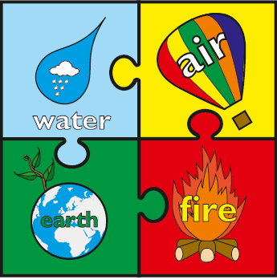

Rewards and Sanctions
Rewards:
Class Dojos – linked to our whole school House System.
Aiming for Excellence,
Acts of Kindness,
Perseverance
Weekly Gold Book.
Notes:
Currently, we are reviewing the whole school behaviour policy. At present these are our rewards and sanctions.
Please discuss the whole class rules and rewards that were created during the first week.

Slide 22
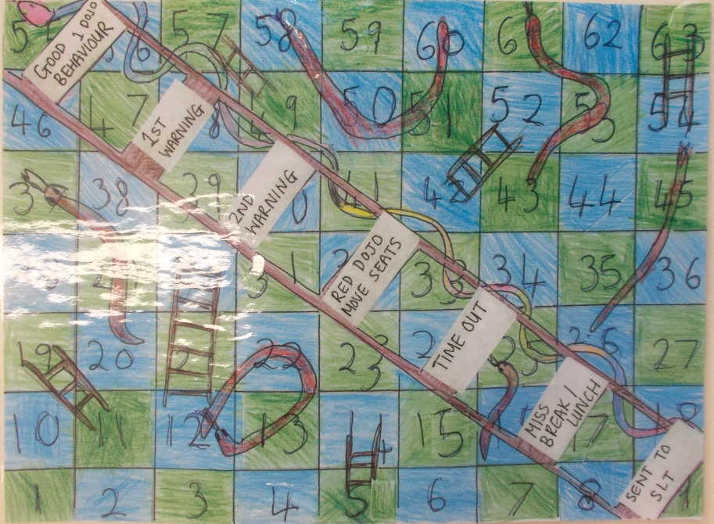
Rewards and Sanctions
Sanctions:

