Slide 1

Welcome to Year 3

Slide 2

Year 3 Team
Class Teacher
Miss Heater
Teaching Assistant
Mrs Riley
Mrs Smith
Add pictures

Slide 3
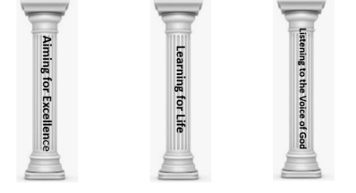

School’s Vision Statement
John 10:10 ‘Life in all its Fullness.’
John 10:10: Life in all its Fullness
Effective teaching and a creative, child centered curriculum, together with an emphasis on Christian values and beliefs, enables all learners to recognise and achieve high standards. Pupils are encouraged to embrace challenges and become lifelong learners in a safe, secure and nurturing environment. We are committed to enriching pupils’ moral and spiritual development inspiring all to become caring, responsible 21st century global citizens.
Notes:
The school’s vision statement is underpinned by the biblical passge of John 10:10 Life in all its fullness.
3

Slide 4
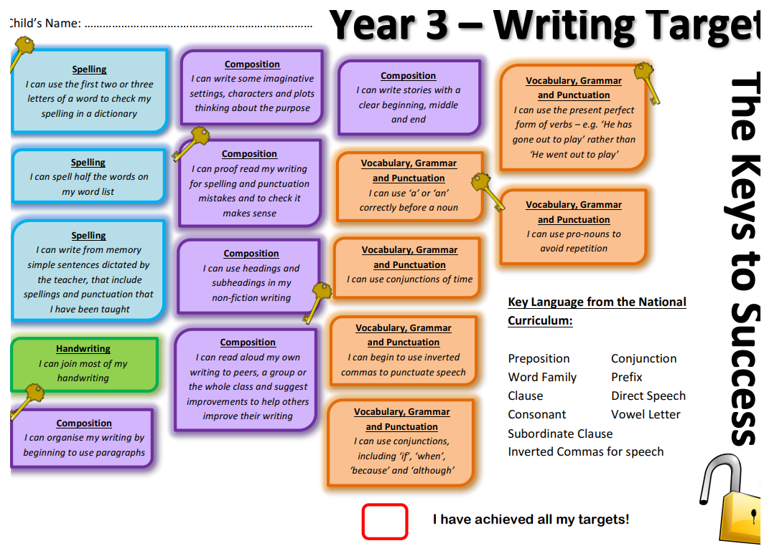

Year 3 - Keys to Success
Notes:
You will need to upload the Keys to Success from the website.

Slide 5
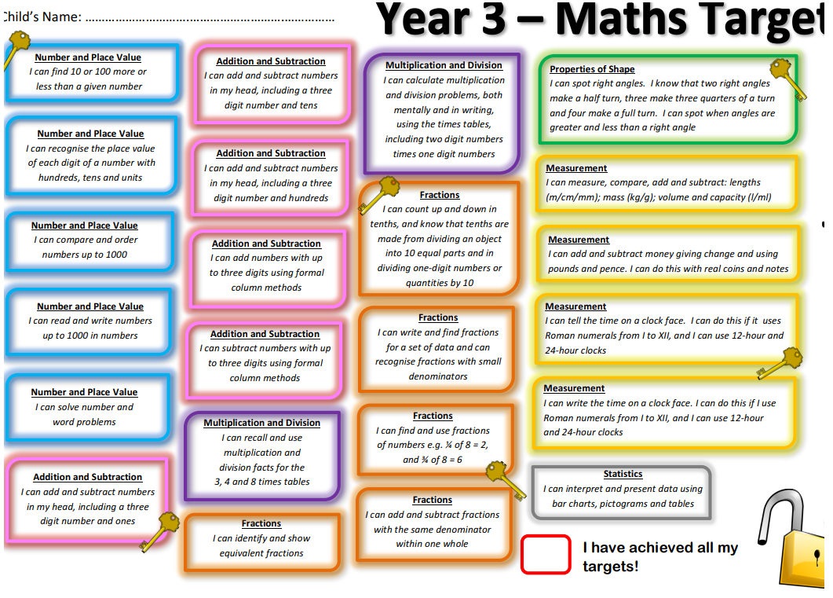
Year 3 - Keys to Success
Notes:
You will need to upload the Keys to Success from the website.

Slide 6
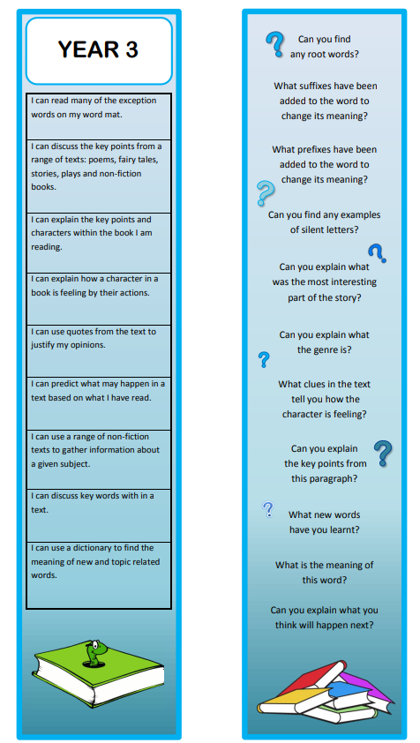

Reading Bookmarks
Notes:
Please add your year group’s book marks to this page.

Slide 7
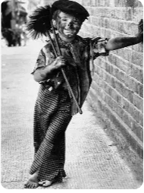

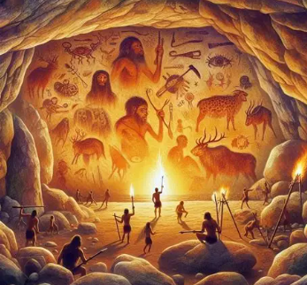


Year Three’s Curriculum
2025 - 2026
Visits, Trips and experiences:
Open Box theatre - Stone Age acting, The History Man - Iron Age learning,
Victorian School Dress up Day, Visit from the RNLI and a trip to Butser Farm
How has life
Changed since the Stone Age?
How was the life of a Victorian child different to ours?
Should rainforests be protected?
Where do people live and why?
This Photo by Unknown Author is licensed under CC BY-NC-ND
Notes:
Please add your completed overview for the Autumn Term

Slide 8
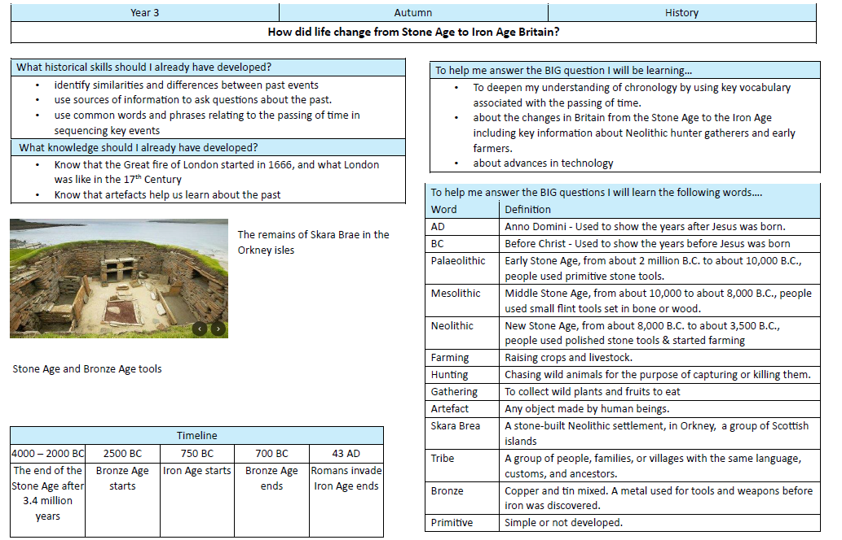

Knowledge Organiser Autumn 1

Slide 9
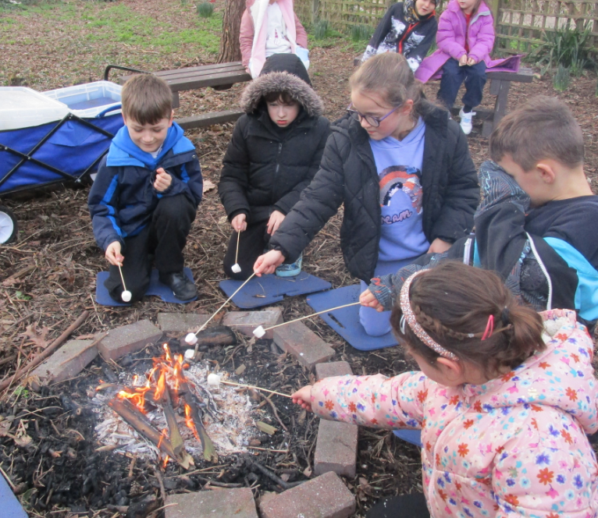

Outdoor Learning
Wednesday 1st October
Once a half term, pupils will take part in outdoor learning activities.
For the first half term, the focus for outdoor learning is DT. Children will learn how to make fires and heating and eating 'Stone Age Soup'. They may wear their own clothes.
Notes:
Please add pictures of your stunning start

Slide 10
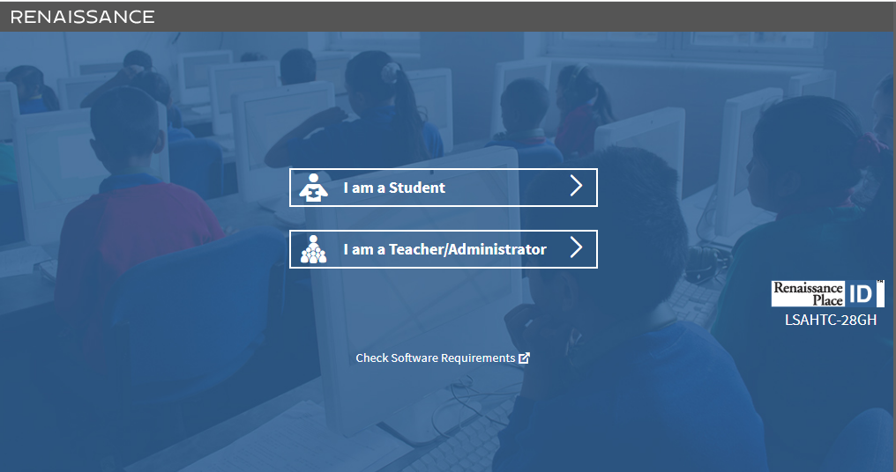

Accelerated Reader
Pupils will take their STAR test this week,
They are given a ZPD – reading range for books,
From this, your child will be set a reading target for the half term,
Children complete quizzes on the book they have read (these contain between 5 – 20 questions)
We aim for children to get an average of 85% or above in their quizzes.

Slide 11


Giving your child an advantage
Reading:
Support your child’s fluency, stamina and understanding by listening to them read for at least 20 minutes a day. Please use your child’s bookmark to deepen their understanding.
Please complete your child’s reading record so we know that they have read and what they are reading.
Notes:
Add and delete as appropriate

Slide 12




I don’t want to read tonight!
Student ‘A’ reads 20 minutes each day.
3600 minutes in a school
year.
Student ‘B’ reads 5 minutes each day.
900 minutes in a school
year.
Student ‘C’ reads 1 minute each day.
180 minutes in a school
year.
1,800,000 words
282,000 words
8,000 words

Slide 13


Home Learning
Research shows that pupils completing their home learning improves progress by 3 months.
Home learning is now set via Google Classroom
Each week your child will receive:
- spellings.
- maths task reviewing the learning from the week.
- In promoting the school’s Christian Values, there may also be
additional whole school challenges set.
See more

Slide 14


Spellings:
Each week your child will have 2 spelling lessons focused around a spelling rule or pattern.
They will then bring home activities to complete as part of home learning to support them to learn these rules.
Children will also be expected to log onto the spelling shed to compete in the online games.
I will talk you through how to do this…
Notes:
Add and delete as appropriate

Slide 15
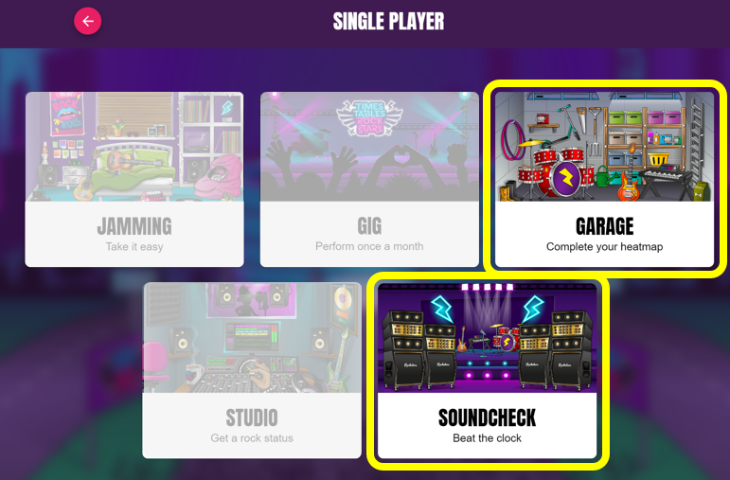
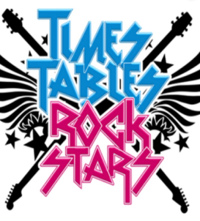
Maths:
In preparing your child for the Year 4 Multiplication Times Table Check, they will have access to Times Table Rockstars.
The aim is to play regularly rather than play for sustained periods of time.
Garage and Soundcheck are the best games to play.

Slide 16
Home Learning
Research shows that pupils completing their home learning improves progress by 3 months.
Home learning is now set via Google Classroom
Each week your child will receive:
- spellings.
- maths task reviewing the learning from the week.
- In promoting the school’s Christian Values, there may also be
additional whole school challenges set.
I will show you what the home page
Looks like.
See more

Slide 17

P.E kit
P.E: Monday and Friday
P.E Kit: Navy shorts (long tracksuit trousers in the winter)
T-shirt, which is their team colour
Trainers for outdoor PE
Warm clothing in winter months such as a navy tracksuit.
If your child has an ear piercing it must be removed for the days that they have PE. Or please provide micro-pore tape that can be kept in school to cover the earring.

Slide 18


Healthy Minds
Please ensure that your child has a clear water bottle in school.
Bottles should be taken home and cleaned regularly.
Pupils may bring in their own fruit snack each day. It is no longer provided every day. If there is spare fruit from KS! It will be offered to KS2
On the days that your child does not do PE, they will walk, skip or run around the Daily Mile for 10 minutes.
Notes:
Delete as appropriate for KS 1 or 2

Slide 19
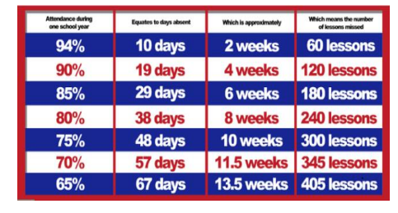

Attendance
The gates open at 8:35am and close at 8:55am. The register is taken at 9:00am.
If your child arrives after 9.15am, this will be recorded as an unauthorised absence.
Attendance of 96%+ is judged to be good.
Notes:
Please add what you give green dojos for

Slide 20

Attendance
Termly Prizes:
At the end of teach term, all children with 97%+ attendance go into a raffle to win a prize.
Pupils who have 100% receive a certificate during Collective Worship.

Slide 21



E-safety
SMART
Monthly newsletters – sent out by the school with useful guidance and links to relevant information

Slide 22
Communication
Class Dojos for rewards and sanctions.
The School’s website.
School’s Facebook page.
MCAS
Class Pages.
(http://www.southbersted.w-sussex.sch.uk/class-pages/)
Weekly newsletters.
Parent teacher consultations.
Interim reports.
End of year reports.
Notes:
Please add what you give green dojos for

Slide 23
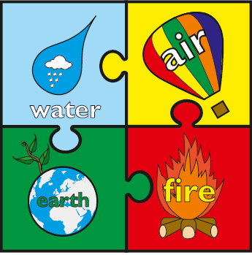

Rewards and Sanctions
Rewards:
Class Dojos – linked to our whole school House System.
Aiming for Excellence,
Acts of Kindness,
Perseverance
Weekly Gold Book.
Notes:
Currently, we are reviewing the whole school behaviour policy. At present these are our rewards and sanctions.
Please discuss the whole class rules and rewards that were created during the first week.

Slide 24
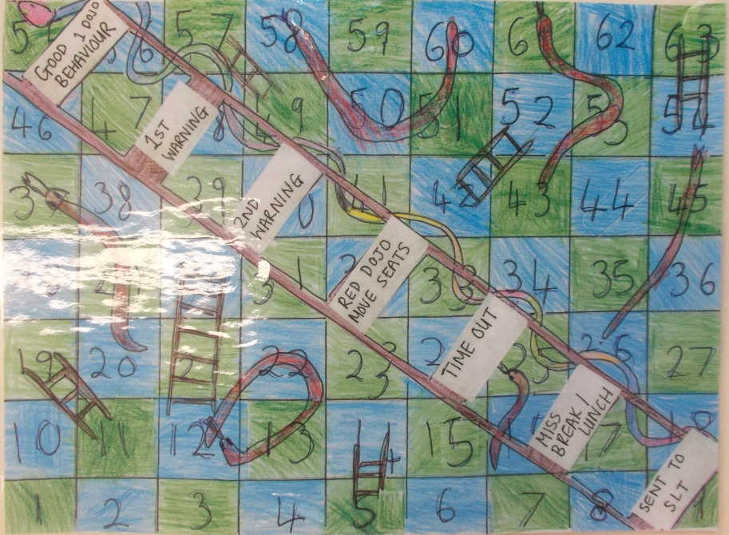
Rewards and Sanctions
Sanctions:

